Slide 1

UNIT 1: Who am I?
Rule of thumb

Slide 2
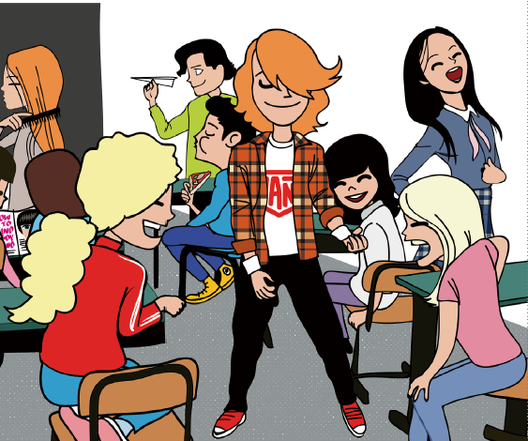
Look at the picture. This is Miss Clarke and her class.

Slide 3
Imagine you’re there. Answer the questions.
How do you feel?
What is the teacher like?
What are the students like?
Do you like the atmosphere in this class?
Why? Why not?
Do you think they can study?

Slide 4
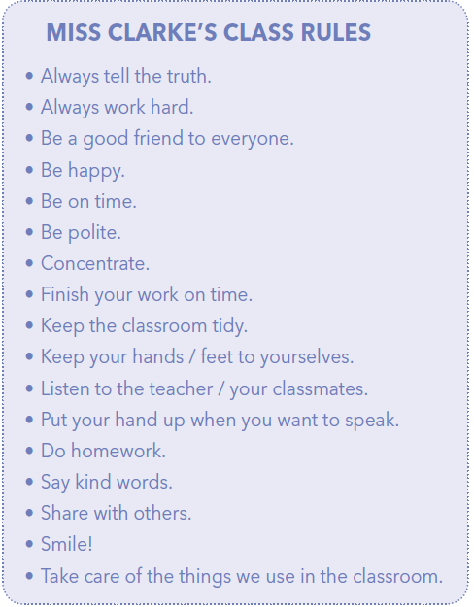
Read the class rules.
Do you know the meaning of the sentences?
Always tell the truth.
Always work hard.
Be a good friend to everyone.
Be happy.
Be on time.
Be polite.
Concentrate.

Slide 5
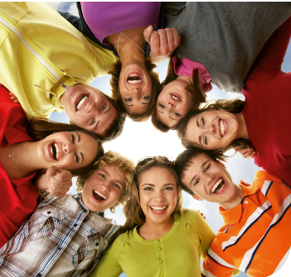
Finish your work on time.
Keep the classroom tidy.
Listen to the teacher / your classmates.
Put your hand up when you want
to speak.
Do homework.
Say kind words.
Share with others.
Smile!
Take care of the things we use in the classroom.

Slide 6
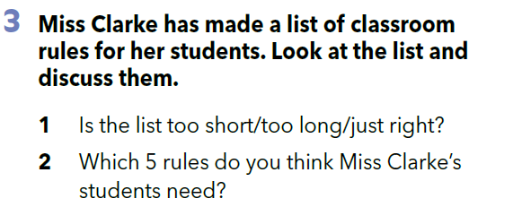
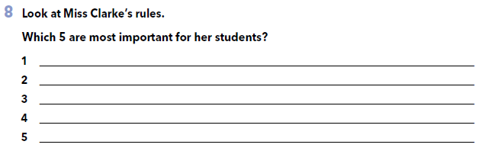

Slide 7

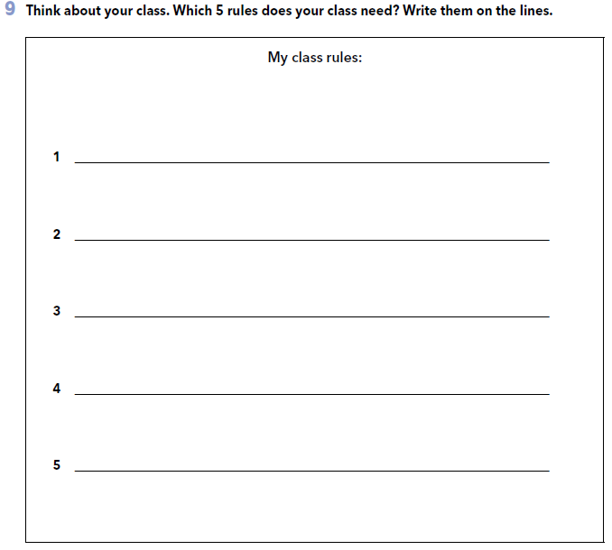
Choose 5 rules from the list or think of your own rules and write them on the lines in task 9 (book, page 19).

Slide 8



Slide 9


Slide 10
Do you remember Miss Clarke’s class rules?
Check the link and complete the task (put the rules in the correct order).
https://www.e-sfera.hr/dodatni-digitalni-sadrzaji/87a3258f-daa1-4640-b54e-cfd0315d3973/

Slide 11
PROJECT TIME
Učitelj će vam podijeliti jedno od pravila ponašanja. Vaš zadatak je predstaviti važnost tog razrednog pravila. Odaberite jedan od ponuđenih načina predstavljanja:
Izraditi strip sa situacijom/situacijama u kojima je važno poštovati to pravilo.
Osmisliti skeč koji se temelji na situaciji u kojoj je važno poštovati to pravilo.
Osmisliti digitalnu reklamu / poster za to pravilo.

